Slide 1


WIND TURBINE
HELIX SHAPE VAWT
GROUP 4:
ANSHUL - 200155
ANUKRITI - 200932
HARSHAL - 200426
KRITIKA - 200524
LAKSHYA - 200543
RANI - 200303
RISHU - 200797
SEE614 - WIND ENERGY
IIT KANPUR​
SHIVANGI - 200942
VIJAYA - 201114
VISHAL - 201129
YUVRAJ - 201171
INSRUCTOR: Dr. Debopam Das

Slide 2
INTRODUCTION
The helix shape vertical axis wind turbine is an innovative and high performance small scale wind turbine solution.
The turbines have scoops, or aerofoils, arranged around a vertical shaft, and they are turned by the wind
Helical wind turbines can be safely operated even during extreme conditions. Another huge advantage of the helical wind turbine is that it can be used much more easily in urban settings. Regular turbines must usually be placed far away from the ground in order to glean the most use out of them.
​
Page
02/08

Slide 3
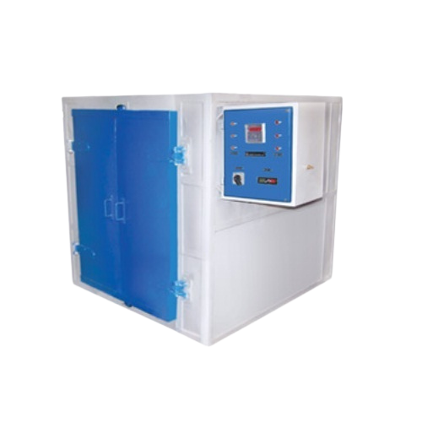
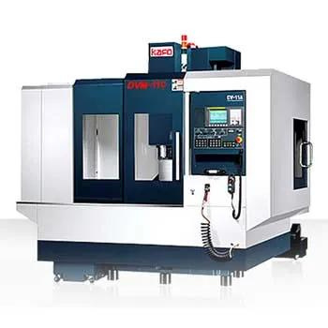
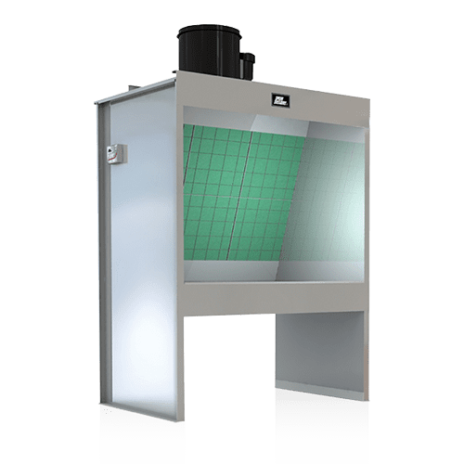
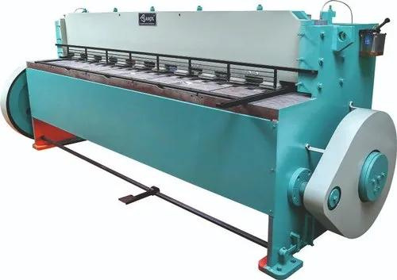
EQUIPMENTS
CNC Machine ​
Routers​
Heating Oven​
Spray Booth
Welding Machine​
Measuring Instruments
Paint
Page
03/08

Slide 4
MATERIALS
Carbon or Glass fiber reinforced plastic ​
Resin & Hardener​
Structural foam
Adhesive
Aluminum or Steel (hub)
Generator
Controllers
Hydraulic and lubrication components
Wires
Gears
Page
04/08

Slide 5
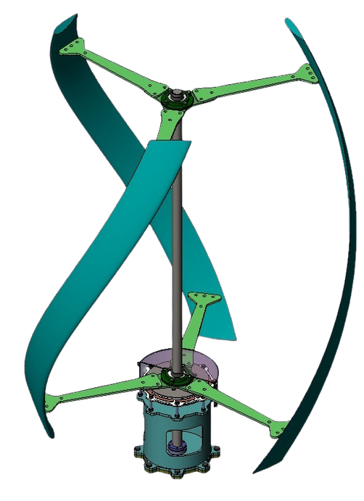
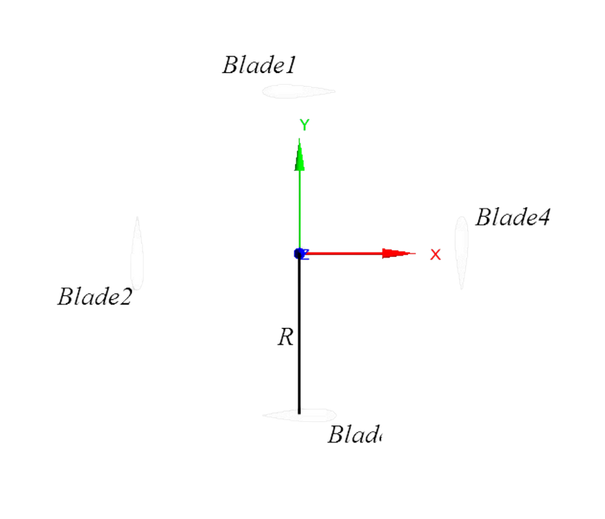
WIND TURBINE MODEL
Page
05/08

Slide 6
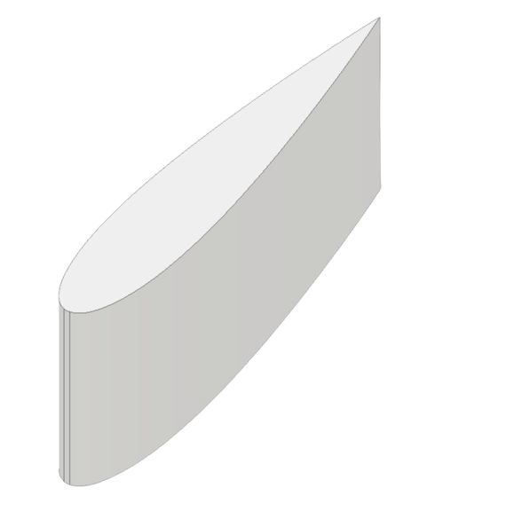
BLADE SPECS
ITEM
DESCRIPTION
Rotor
Air Foil
Rated Wind Speed
Swept Area
Rotor Radius
Rotor Height
Number of Blades
Chord Length
Solidity
Helical
NACA 0018
10m/s
1.57 m^2
0.55 m
1.43 m
4
0.25 m
0.3
Page
06/08

Slide 7
REFERENCE
https://www.mdpi.com/1996-1073/11/6/1517
Book : INNOVATIVE WIND TURBINES - Vaughn Nelson
Page
07/08

Slide 8

THANK YOU!

